Slide 1
Serverless Azure functions
… in
LINKIT x PyLadies Amsterdam
Dana Arsovska x Alyona Galyeva
March 31th, 2020

Slide 2

About me
Data Engineer @ LINKIT
Previously: Software Engineer
Background in Robotics
Interested in Data Intensive Systems
LinkedIn: https://www.linkedin.com/in/dana-arsovska/

Slide 3

Agenda
Why Cloud Computing?
What is Cloud Computing?
Why serverless?
Azure Functions in Python
Python Code Refactoring
Live Coding

Slide 4
Why cloud computing?

Slide 5
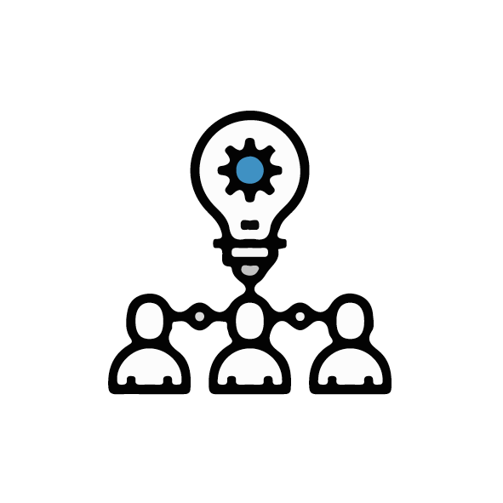

Why cloud computing?
Assume you have an idea for an awesome application!
In order to reach your target audience you have to deploy it!

Slide 6

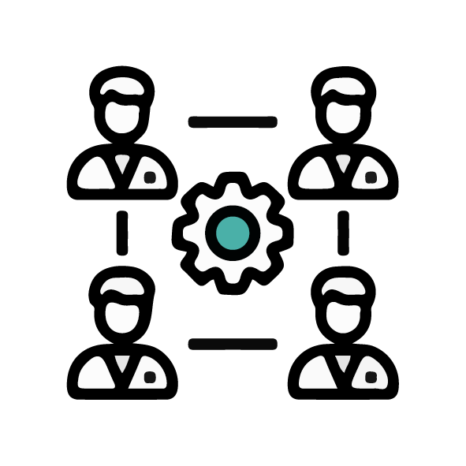


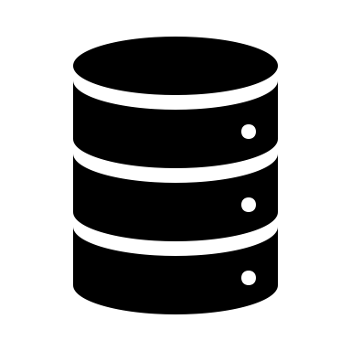
Why cloud computing?
To deploy your app you’ll need

Slide 7


Why cloud computing?
The initial setup is expensive
It is also risky!

Slide 8
What is cloud computing?

Slide 9


What is cloud computing?
Cloud computing is a platform that provides access to computing resources over the internet.
User
Cloud
Resources

Slide 10



What is cloud computing?
Datacenters
Cloud providers own massive datacenters with hundreds of
servers and storage systems
Services
Cloud providers offer many cloud computing services
Cost effective
Users only pay for the services they use

Slide 11







What is cloud computing?
AI + ML
Analytics
Compute
Containers
Databases
Migration
Networking
Security

Slide 12
What is Azure?
Azure is an ever-expanding set of cloud computing services provided by Microsoft.

Slide 13
What is serverless?

Slide 14
Azure Functions
Azure Functions is a serverless compute service that lets you run event-triggered code without having to explicitly provision or manage infrastructure.

Slide 15


Azure Functions
Think of Azure Functions as…
Code
Events + Data
Azure Functions

Slide 16
Event driven architecture
Services
Event source
Serverless function

Slide 17
Azure Functions
Easily build applications using serverless functions.

Slide 18
Azure Functions
Manage your application instead of infrastructure.

Slide 19
Azure Functions
Choice of language
Pay-per-use pricing model
Bring your own dependencies
Integrated security
Simplified integration
Flexible development/deployment
Open-source

Slide 20
Azure Functions
Azure Functions are great for processing data, integrating systems, working with IoT, simple API’s and microservices.
Azure Functions supports:
Triggers - a way to start execution
Bindings - a way to simplify code for input and output of data

Slide 21
Azure Functions
Triggers
Bindings

Slide 22

Azure Functions & Python
&
2019
Python Support
2016
Azure Functions Released

Slide 23
Best practices

Slide 24

Best Practices
def get_max_d_from_df(df): pass
The function should:
Have a reasonable name
def get_max_number_of_days(dataframe): pass

Slide 25
Best Practices
The function should:
Have a reasonable name
Have a single responsibility
def calculate_and_print_stats(list_of_numbers): sum = sum(list_of_numbers) mean = mean(list_of_numbers) median = median(list_of_numbers) mode = mode(list_of_numbers) print('-----------------Stats-----------------') print('SUM: {}'.format(sum) print('MEAN: {}'.format(mean) print('MEDIAN: {}'.format(median) print('MODE: {}'.format(mode)

Slide 26
Best Practices
The function should:
Have a reasonable name
Have a single responsibility
Be short (and readable)
Red flags:
You can't immediately determine the function's purpose;
Deeply nested control structures;
Logic that is duplicated in other methods;
Your massive developer-grade display isn't big enough to display it;

Slide 27
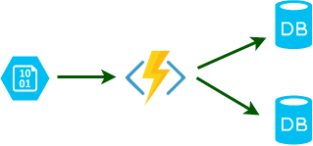
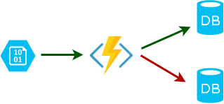
Best Practices
The function should:
Have a reasonable name
Have a single responsibility
Be short
Be idempotent
Must properly validate input events and identify if the events have been processed before.

Slide 28
Best Practices
The function should:
Have a reasonable name
Have a single responsibility
Be short
Be idempotent
Extract unique attribute.
Check if it exists in a control database.
If it exists, gracefully terminate the execution.
If it doesn't exist, continue the execution normally.
4. When the function work finishes successfully, include a record in the control database
5. Finish the execution.

Slide 29
Best Practices
The function should:
Have a reasonable name
Have a single responsibility
Be short
Be idempotent
Finish as quickly as possible

Slide 30
Best Practices
The function should:
Have a reasonable name
Have a single responsibility
Be short
Be idempotent
Finish as quickly as possible
Avoid (or set up the depth of) recursions

Slide 31
Best Practices
The function should:
Have a reasonable name
Have a single responsibility
Be short
Be idempotent
Finish as quickly as possible
Avoid (or set up the depth of) recursions
Be stateless
You don’t control where and when function instances are provisioned or deprovisioned;
There is no way to store data within the process between requests reliably;
External storage has to be utilized;

Slide 32
Best Practices
The function should:
Have a reasonable name
Have a single responsibility
Be short
Be idempotent
Finish as quickly as possible
Avoid (or set up the depth of) recursions
Be stateless
Include a docstring

Slide 33
Best Practices
The function should:
Have a reasonable name
Have a single responsibility
Be short
Be idempotent
Finish as quickly as possible
Avoid (or set up the depth of) recursions
Be stateless
Include a docstring
Defensive functions
Assume that errors are going to arise.
Use assertions.
Use preconditions to check that the inputs to a function are safe to use.
Use postconditions to check that the output from a function is safe to use.
Write tests before writing code.

Slide 34
Best Practices
The function should:
Have a reasonable name
Have a single responsibility
Be short
Be idempotent
Finish as quickly as possible
Avoid (or set up the depth of) recursions
Be stateless
Include a docstring
Defensive functions
Don’t hardcode secrets!

Slide 35
What you need to consider?
Serverless is not right for every project
- You want control
- Your workloads are constant
- You have long running functions
- You use unsupported language
Structure you code following best practices & Optimize your code for the billing model
Log everything

Slide 36
Let’s create our first Serverless Function!
Go to:
https://github.com/pyladiesams/Azure-functions-beginner-mar2020

